Slide 1












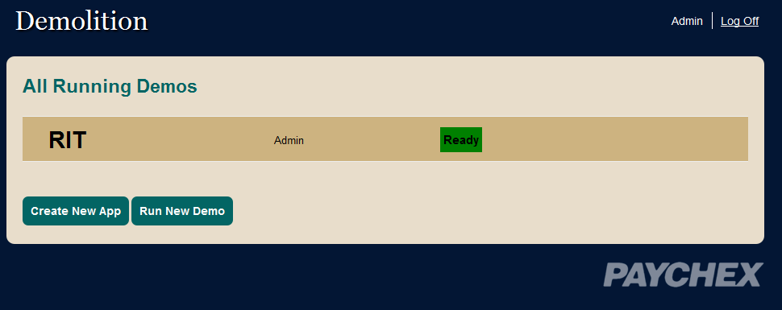
AMAZON CLOUD DEMONSTRATION ENVIRONMENT
Anne Markis, Christopher White, Robert Jones, Nicholas Quaranto, Jennifer Goldbach
Sponsors: Duane Gosley, Michael Mosley Faculty Advisor: Tom Reichlmayr
Project Overview
Project Design
Technologies
Application
The Amazon Cloud Sales Demonstration Website involves creating an environment where Paychex can depoly their applications for demonstration on Amazon EC2. The company’s current demonstration process is inefficient to set up for hundreds of sales representatives distributed across the country. Team Sentinel Prime will be creating a demonstration platform that will allow untrained sales reps to effectively demonstrate the Paychex product suite. Data integration across the various applications will allow sales reps to show customers the benefits of using multiple products to manage their payroll and human resource efforts. Cloud computing will allow Paychex sales reps to easily demonstrate their offerings to customers across many industries. In an effort to make the demonstrations seem fresh and relevant, there must be a method of providing and maintaining a set of realistic data for customers to evaluate.
Demo
Application
Demolition Website
Application
Website where salespeople create demos
Maintained on an EC2 instance
Demo
Application
Customized Demonstration
Select only appropriate applications
The team chose to use SCRUM as a process methodology. Because of the short timeframe of the project, 2 week iterations were chosen. A project backlog and sprint backlog were maintained. At the end of each iteration, Paychex signed off completed features, and the team held a retrospective and planned the next sprint with Paychex to ensure the most important features were completed.
User stories were extracted from the Paychex proposal, and the team assigned story points to these, and planned iterations based on the number of story points in each feature. The team had an extensive Iteration Zero, used for planning, design, and learning new technologies. Here is a summary of features completed during each iteration:
Iteration 1: Create DB schema, create demo apps, manual deploy process
Iteration 2: Automate deploy process
Iteration 3: User authentication and create/destroy demo
Iteration 4: Begin data integration and single sign-on
Iteration 5: Complete data integration, add industries
Iteration 6: Administration monitoring features
Process
Features
Select dataset for demos
Select which applications to demonstrate
EC2 instances terminate after demonstrations, saving money
Datasets can be updated through Demolition website
Upload any application to demonstrate on an instance
Administrator mode to monitor current instances, or update applications and data
Design
Future Plans
Paychex to integrate Demolition with their current demonstration applications
Paychex will integrate their own databases with Demolition and their apps
Create Amazon accounts for salespeople and begin demonstrations on EC2

Slide 2



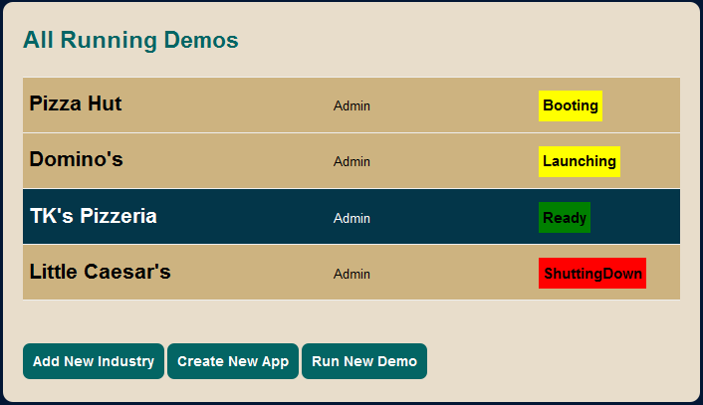
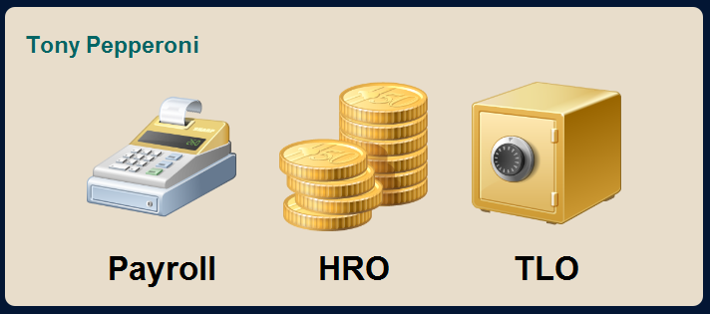
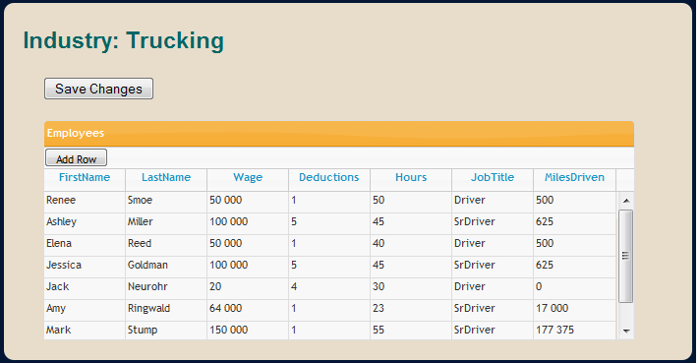
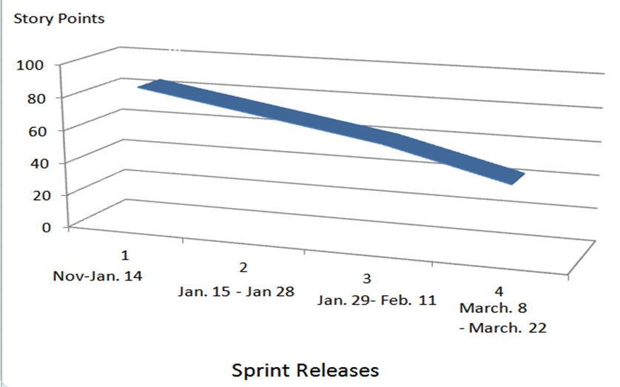
SENTINEL
PRIME
Anne Markis, Jennifer Goldbach, Robert Jones, Nicholas Quaranto, Christopher White
Sponsors: Duane Gosley, Michael Mosley Faculty Advisor: Tom Reichlmayr
BACKGROUND
FEATURES
Paychex sales staff give live demonstrations of various Human Resources and Payroll products to potential clients.
Sales representatives collaborate with system administrators to rig up demos tailored to individual corporations.
Point 1
Point 2
Point 3
Point 4
Point 5
SCREENSHOTS
MOTIVATION
ARCHITECTURE
The demonstration process is difficult to set up for sales representatives
Data integration between applications is hard to demonstrate live
Customizing data for specific demos is a time consuming and laborious process
Point 1
Point 2
Point 3
Point 4
Point 5
PROCESS: SCRUM
Point 1
Point 2
Point 3
Point 4
Point 5
TECHNOLOGY
FUTURE PLANS
Point 1
Point 2
Point 3
Point 4
Point 5
Point 1
Point 2
Point 3
Point 4
Point 5
BURNDOWN

Slide 3
Application
Demo
Application
Demolition Website
Application
Demo
Application

